Slide 1
CONFIDENTIAL
Direct Investments In
Office Properties
Leased To U.S. Government Agencies
June - 2016

Slide 2
Executive Summary
Exclusive focus on class “A” office properties leased to and occupied by U.S. government agencies
Highest tenant credit with the “full faith and credit” of the U.S. government (Article IV, Section 1 of the U.S. Constitution)
Demand for space less sensitive to the volatility of economic cycles
Government leased property portfolio has grown every year for the past 10 years
Low correlation to other asset classes with high resiliency and protection against downside risk
Standard firm 10–year leases with no lease break clauses resulting in security of income stream
Contiguous tenancy with historically high lease renewal rate of over 90%
Stabilized and inflation-adjusted targeted unleveraged income return of about 7.0% per annum¹ with potential for capital appreciation
Genesis Group of Companies
A highly specialized owner and manger who is responsible for US$400 million of equity invested since 1999
Launched a US$180 million Unit Investment Trust Program by raising capital from retail and institutional investors
Acquired US$123 million of office properties, hired management team and successfully launched a US$192 million public market IPO (NYSE: GPT) which was 11x oversubscribed
Appointed as exclusive investment advisor to handle the acquisition, asset management and property management of U.S. GSA office properties by three large German institutional real estate investors:
Ärzteversorgung Westfalen-Lippe, a real estate investment manager for Germany’s largest doctor pension fund (www.aevwl.de)
KanAm Grund, one of the largest open-end real estate publicly traded funds focusing on U.S. Class “A” properties (www.kanam.de)
LB Immo Invest GmbH, an investment company investing in U.S. Federal Government real estate assets (www.patrizia.ag)
Fully-integrated in-house capability and experience in acquisitions, asset and property management, leasing and development
Currently owns and manages over 80 U.S. government office properties in 28 states, individual value up to US$15 million
Accelerating investment pipeline
Current access to approximately US$150 million of potential investment opportunities
Growing pipeline in office properties reflecting growing office space demand by U.S. Federal Government agencies
¹ Targeted returns are based on projections and there can be no assurance that such projections will prove to be accurate.

Slide 3
Company Overview
Genesis International, LLC
Founded in 2005, as an advisor and service provider to international institutional real estate investors
An affiliated company, Genesis Financial Group, Inc., a full-service real estate group established in 1994 providing services in acquisition, development, asset management, property management and consulting
Principals with 25+ years of experience sourcing and managing commercial office properties leased to the Federal Government throughout the continental United States, including Hawaii, Alaska and Puerto Rico
Exclusive focus on U.S. Federal Government real estate market
Responsible for approximately US$400 million of equity invested in properties totalling over 1.5 million square feet
Appointed as exclusive investment advisor by three German institutional real estate investors focusing on Class “A” office properties leased to U.S. Federal Government agencies (copies on Engagement Letter and Acknowledgement Letter in Appendix)
An approved property management agent and preferred developer of the U.S. Federal Government
Consistently rated in the top 10% of all managers of U.S. Federal Government leased properties as determined by the Gallup Poll Organization

Slide 4
Company Overview (cont’d)

Slide 5
Unique Features of U.S. Federal Government Office Market
Class “A”, stand-alone, single-tenanted properties in major and tertiary markets
Demand for space driven by social missions instead of economic goals
Property value and demand for space much less sensitive to volatility of business cycles
Standard firm leases of 10+ years with no lease break clauses, i.e., no early lease termination rights
Renewal rental income increases averaged 12-25% after initial lease term
Real estate taxes amounts are capped at a negotiated fixed base stop
Average stay by a federal agency in one location is 30+ years, minimizing flight and vacancy risk
Highest historical lease renewal rates at 90%+
Standard lease contracts and terms with high transparency resulting in transaction efficiency and lower costs
Low property operating costs, capital expenditures and reserve requirements
Stable, secure and inflation-adjusted cash flow distributions to owners and investors

Slide 6
Probability of Lease Renewals
US Office Renewal Rates for GSA Agencies vs. Typical Office Tenants
First Generation Lease - GSA
All Government Properties (Federal, State, Communal)
Typical Class A Office Building
Source: Dr. Dennis Eisen, Government Leasing News / RERC

Slide 7
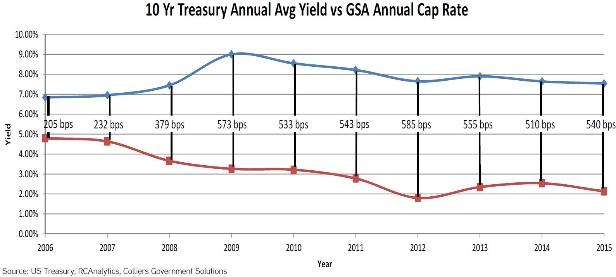
Average Yield Spreads

Slide 8
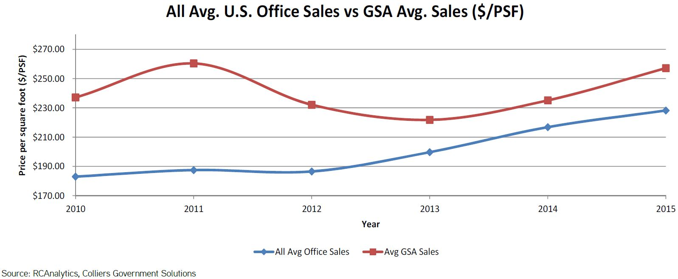
Average Sales

Slide 9
Examples of Government Agency Tenants
Department of Justice | Federal Bureau of Investigation
Department of Energy | Drug Enforcement Agency
Department of Defense | Department of Commerce
Department of Agriculture | Environmental Protection Agency
General Services Administration | Department of Homeland Security
Department of Labor | Social Security Administration
Department of State | Department of Transportation
Department of Treasury | Postal Service
Federal Emergency Management Agency | U.S. Army
U.S. Navy | Department of Veterans Affairs
Forestry Service | Corps of Engineers
Bureau of Land Management | Department of Health and Human Services

Slide 10
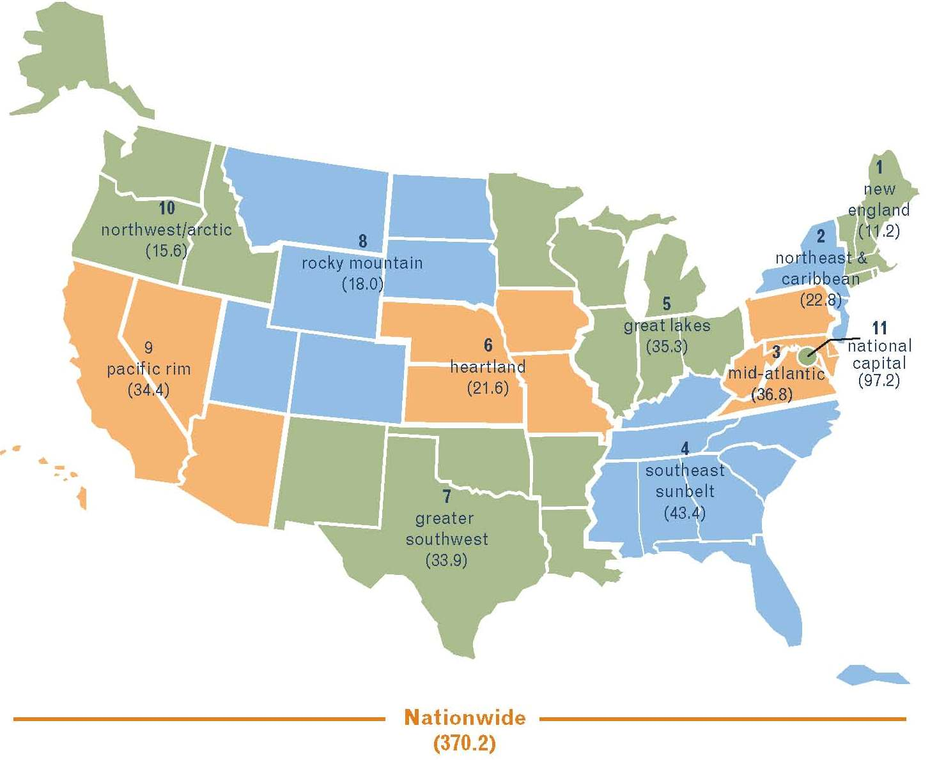
Market Outlook
GSA’s Owned and Leased Real Estate Portfolio By Region FY 2014
(In Millions of Square Feet)
Source: GSA Public Buildings Services, State of the Portfolio FY 2014

Slide 11
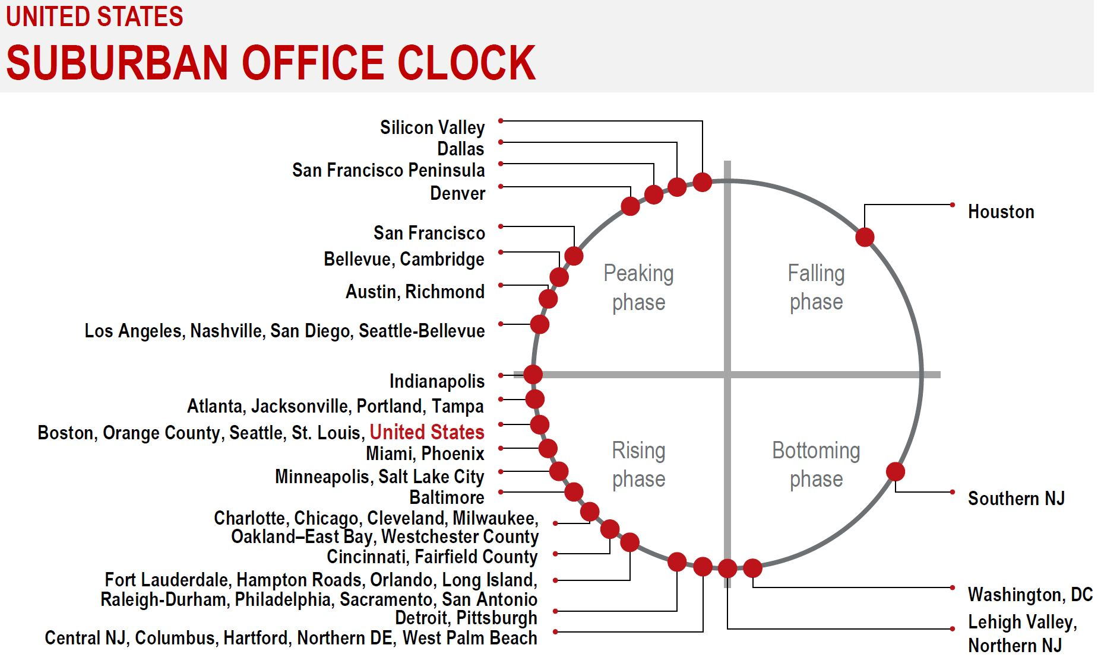
Market Outlook

Slide 12
Investment Approach
Exclusive focus on U.S. Federal Government office properties in all markets with excess land for expansion
In-depth study of demographics requiring the presence of a federal agency for long term social mission
Detailed analysis of local economics, subject location, surrounding market, subject’s competitive position, recent construction and space absorption, proposed development, sales and rental comparables, and a financial due diligence evaluation of the proposed investment, including cash flow projections with disclosure of all assumptions utilized and sensitivity analysis
Proprietary access to a database of owners and developers totaling over 8,700 leased properties across the U.S.
Seek to acquire assets located on main streets and immediate to mass transit systems
Careful selection of environmentally friendly properties with open floor plans for easy tenant improvements
Acquisitions underwritten with multiple leasing scenarios and exit strategies
Collaborate major decisions at the investment level when joint venture partners are involved
Active and direct property management of each property
Investment opportunities to include acquisitions of properties and other real estate related securities or loans

Slide 13
Investment Management and Advisory Experience
US$180 million Unit Investment Trust Program
Structured 25 separate Unit Investment Trusts “(UIT”) from 1999 to 2006
Raised US$180 million from retail and institutional investors and deployed said capital into 39 properties across the U.S.
Portfolio annual income return exceeded that of NCREIF (National Council of Real Estate Investment Fiduciaries) Office Index from 2001 to 2004, http://www.ncreif.org
US$192 million public market IPO in 2004 (NYSE: GPT)
Invested US$123 million in a portfolio of government leased office properties
Hired management team and established public company infrastructure
Raised US$192 million through a NYSE Listed REIT, Government Properties Trust, Inc. (NYSE: GPT) via selling 19.3 million shares
Initial public offering oversubscribed 11x
Exclusive investment advisor for three German institutional real estate investors focusing on U.S. Federal Government office properties
Ärzteversorgung Westfalen-Lippe, a real estate investment manager for Germany’s largest doctor pension fund (www.aevwl.de)
KanAm Grund, one of the largest German open-end real estate publicly traded funds focusing on Class “A” properties (www.kanam.de)
LB Immo Invest GmbH, an investment company (now part of PATRIZIA Immobilien AG, a publicly traded company) investing in U.S. Federal Government real estate assets (www.patrizia.ag)
Real I.S., a real estate investment manager for retail & institutional investors with €8.0 billion of assets under management

Slide 14
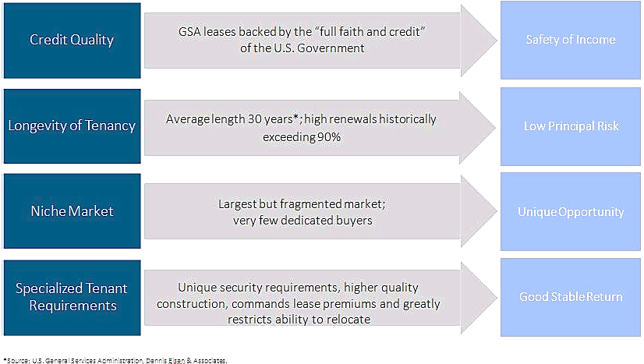
Features and Benefits of the GSA Market
Capitalization Rate: A rate of return on a real estate investment property/lease based on the

Slide 15
Summary
Experienced investment management team and advisor focused exclusively on single-tenanted, high-occupancy U.S. Federal Government leased and occupied office properties
Highest tenant credit with the “full faith and credit” of the U.S. Federal Government (Article IV, Section 1 of the U.S. Constitution)
Disciplined adherence to investment philosophy and risk management
Fully-integrated in-house capability and experience in acquisitions, asset and property management, leasing, and development
Access to proprietary deal flow from strategic relationships with government agencies, government approved developer network and broker contacts
Current investment opportunities reflect distressed assets requiring new capital and a growing demand of office space by U.S. Federal Government agencies

Slide 16
Appendix

Slide 17
Appendix
Professional Biographies
Acquisition Process Chart
Asset and Property Management Chart
Engagement & Acknowledgement Letters

Slide 18
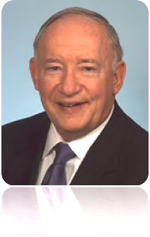
Professional Biographies
D. James Barton
Managing Director, Genesis International, LLC
President, Genesis Financial Group, Inc.
Mr. Barton is a co-founder of Genesis International, LLC (“GI”) with his son, Gregg S. Barton and Thomas Ernst. He is also the co-founder of Genesis Financial Group, Inc. (“GFG”). He manages the overall investment activities of GFG and GI as well as acquisition, disposition, development and management of properties leased to Federal Government agencies throughout the United States for GFG. Together, he and Gregg have formed the father and son team which has structured more than 25 separate private placement unit investment trusts owning real estate and a publicly registered US $25 million REIT holding federal government leased properties. Subsequently, the REIT was renamed Government Properties Trust and raised US $192 million in its fully underwritten follow-on offering in January 2004 (NYSE: GPT). He represents GFG and GI in consulting agreements with international banks and investment funds in Europe for their investments in U.S. federal leased government properties. KanAm of Frankfort, Germany was a major client. He is the managing member of American Government Properties, LLC and Genesis Development Group, LLC which currently have two US Government buildings completing construction. He also established joint ventures with international investors, including Gen-Net US Government Lease, SAFI, a Costa Rican Corporation whose stock was sold on the Central American exchanges. Prior to the formation and development of GFG and GI, Mr. Barton was President and Senior Partner of a medium-sized Detroit law firm, directly responsible for the closing of over $2 billion of real estate transactions.
Mr. Barton is a Michigan-registered real estate broker. Mr. Barton is a graduate of Wayne State University and the University of Michigan and is licensed to practice law in Michigan and Florida. He is a Captain and Chief Legal Officer (Ret.) of the Civil Air Patrol, Michigan Wing, US Air Force.

Slide 19
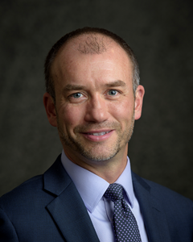
Professional Biographies (cont’d)
Gregg S. Barton
Managing Director - Acquisitions Director, Genesis International, LLC
Vice President - Acquisitions Director, Genesis Financial Group, Inc.
Mr. Barton is a co-founder of Genesis International, LLC (“GI”). Gregg also co-founded Genesis Financial Group, Inc. (“GFG”) which specializes in acquiring, developing, owning and managing properties leased to federal government agencies throughout the United States. He has more than 18 years of experience negotiating and structuring acquisition opportunities for GFG and other affiliated companies. Mr. Barton has created a proprietary national network of relationships with government tenants, developers, brokers and other principals. During his career, he has been involved in over $1 billion of real estate transactions and has structured more than 25 separate private and publicly registered real estate offerings including a NYSE REIT offering, Government Properties Trust (NYSE: GPT). With an established national reputation in government property investments, Mr. Barton expanded the scope of GFG to include international investors from Latin America and Europe. In 2003, he co-founded Gen-Net U.S. Government Lease, SAFI, a listed Costa Rican company, dedicated to purchasing United States Federal Government properties for Central American institutional investors. In 2005, he co-founded Genesis International, LLC (GI) with his father and Thomas Ernst of Geneva, Switzerland. to structure U.S. Federal Government properties for both European institutional, investment funds and high-net-worth investors.
A graduate of the University of Michigan with a BA in International Economics and Finance, Mr. Barton holds a Michigan real estate license and is currently a member of The Federal Government Contractors Group, IREA and the GSA PBS Industry Relations Group. Mr. Barton also carries the LEED Green Associate designation and founded Government Real Estate Advisors, LLC in 2012 as a Registered Investment Advisor company. Mr. Barton is a Registered Investment Advisor.

Slide 20
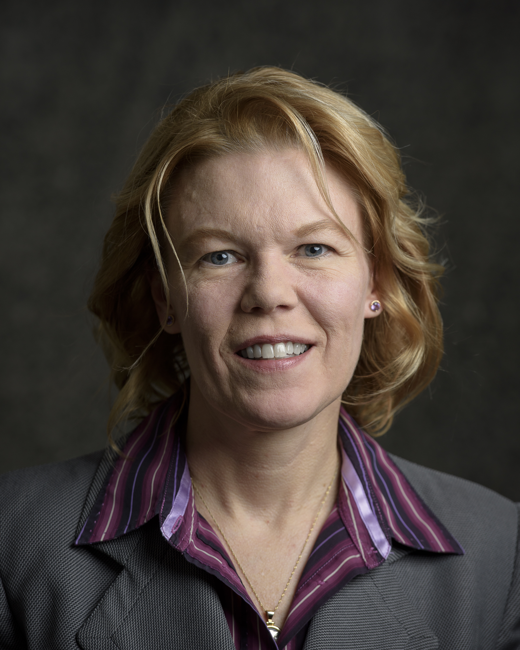
Professional Biographies (cont’d)
Lauren J. Bear
Member, Genesis International, LLC
A 20-year veteran of business ownership, Ms. Bear founded and is President of Bear Wells Investment Realty. Ms. Wells is a licensed real estate broker in the state of Washington. She is also the granddaughter of U.S. Supreme Court Justice William O. Douglas. Bear Wells Investment Realty specializes in acquiring, developing, owning and brokering properties leased to federal government agencies throughout the United States. Ms. Bear has more than 13-years of experience negotiating and structuring these specific acquisition opportunities for domestic and international clients, Genesis International LLC (“GI”), Genesis Financial Group, Inc. (“GFG”), and other clients listed among the “Forbes 100 wealthiest Americans”. Ms. Bear has created a proprietary national network of relationships with government developers, principals and federal tenants ranging from the FBI, DEA, to the U.S. Bureau of Land Management, Customs, FEMA, Border Patrol and Immigration. During her career, she has been integral to the successful sale and/or construction of over 100 US federal properties. Ms. Bear was also responsible for the delivery of over 50% of the federal properties that comprised the historical-first IPO of a publicly registered, 100% federal building REIT onto the NYSE. Ms. Bear introduced GFG into Latin America through relationships that brought GFG into close cooperation with the former President of Costa Rica. That relationship is ongoing. GFG has ventured into other Latin American countries with their investment offerings in U.S. federal buildings. In 2005, Ms. Bear was in Europe and assisted the co-founding of Genesis International, LLC, which is dedicated to purchasing U.S. Federal Government properties for both institutional and high-net-worth investors. Since its founding, European investment funds has invested 5 billion Euros in U.S. federal properties through GI. Nearly $100 million were invested in federal buildings through GI in its first year, 2007.

Slide 21
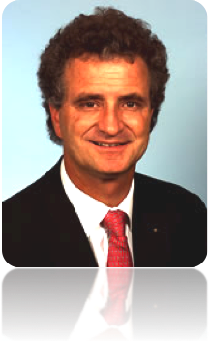
Professional Biographies (cont’d)
Thomas Ernst
Managing Director, Genesis International, LLC
Mr. Ernst has over 20 years of experience with senior positions in the real estate industry and possesses a wide network of contacts in the real estate sector in Europe. From 2005 to 2006, he was the real estate advisor to the CEO of Telecom Bulgaria, charged with restructuring Bulgaria’s largest property portfolio, with several thousand central locations all over the country. He is the co-founder and owner of a real estate investment company with 350 commercial and residential units in the center of Berlin with investments over 20 million Euros. Between 1993 and 1996, Mr. Ernst was the Managing Director of one of the largest German commercial property development corporations with a total of over 2 billion Euros in real estate assets. From 1990 to 1993, Mr. Ernst was the head of central real Estate sales at the Treuhandanstalt Berlin, which privatized all the property assets of the former East Germany. He negotiated and led a team that generated annual sales in excess of 1 billion Euros. In 2005, he co-founded Genesis International, LLC (GI) with D. James Barton and Gregg S. Barton to structure U.S. Federal Government properties for both European institutional, investment funds and high-net-worth investors. Mr. Ernst holds a law degree of Heidelberg University and a BA in Economics from Freiburg University. He is fluent in six languages.

Slide 22
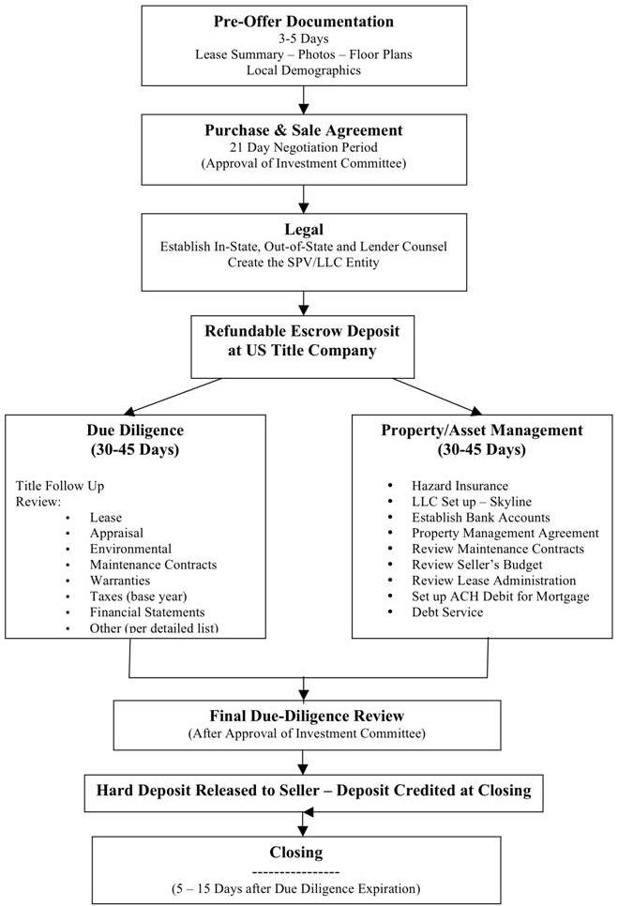
Acquisition Process

Slide 23
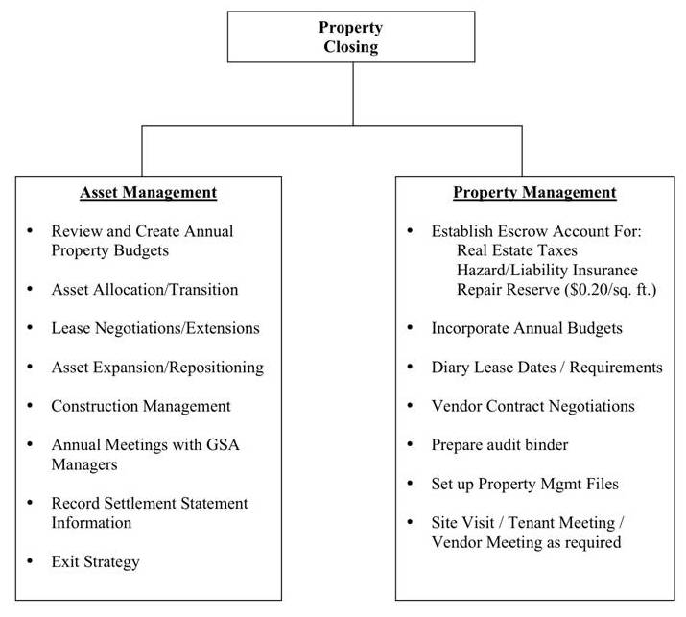
Asset and Property Management

Slide 24
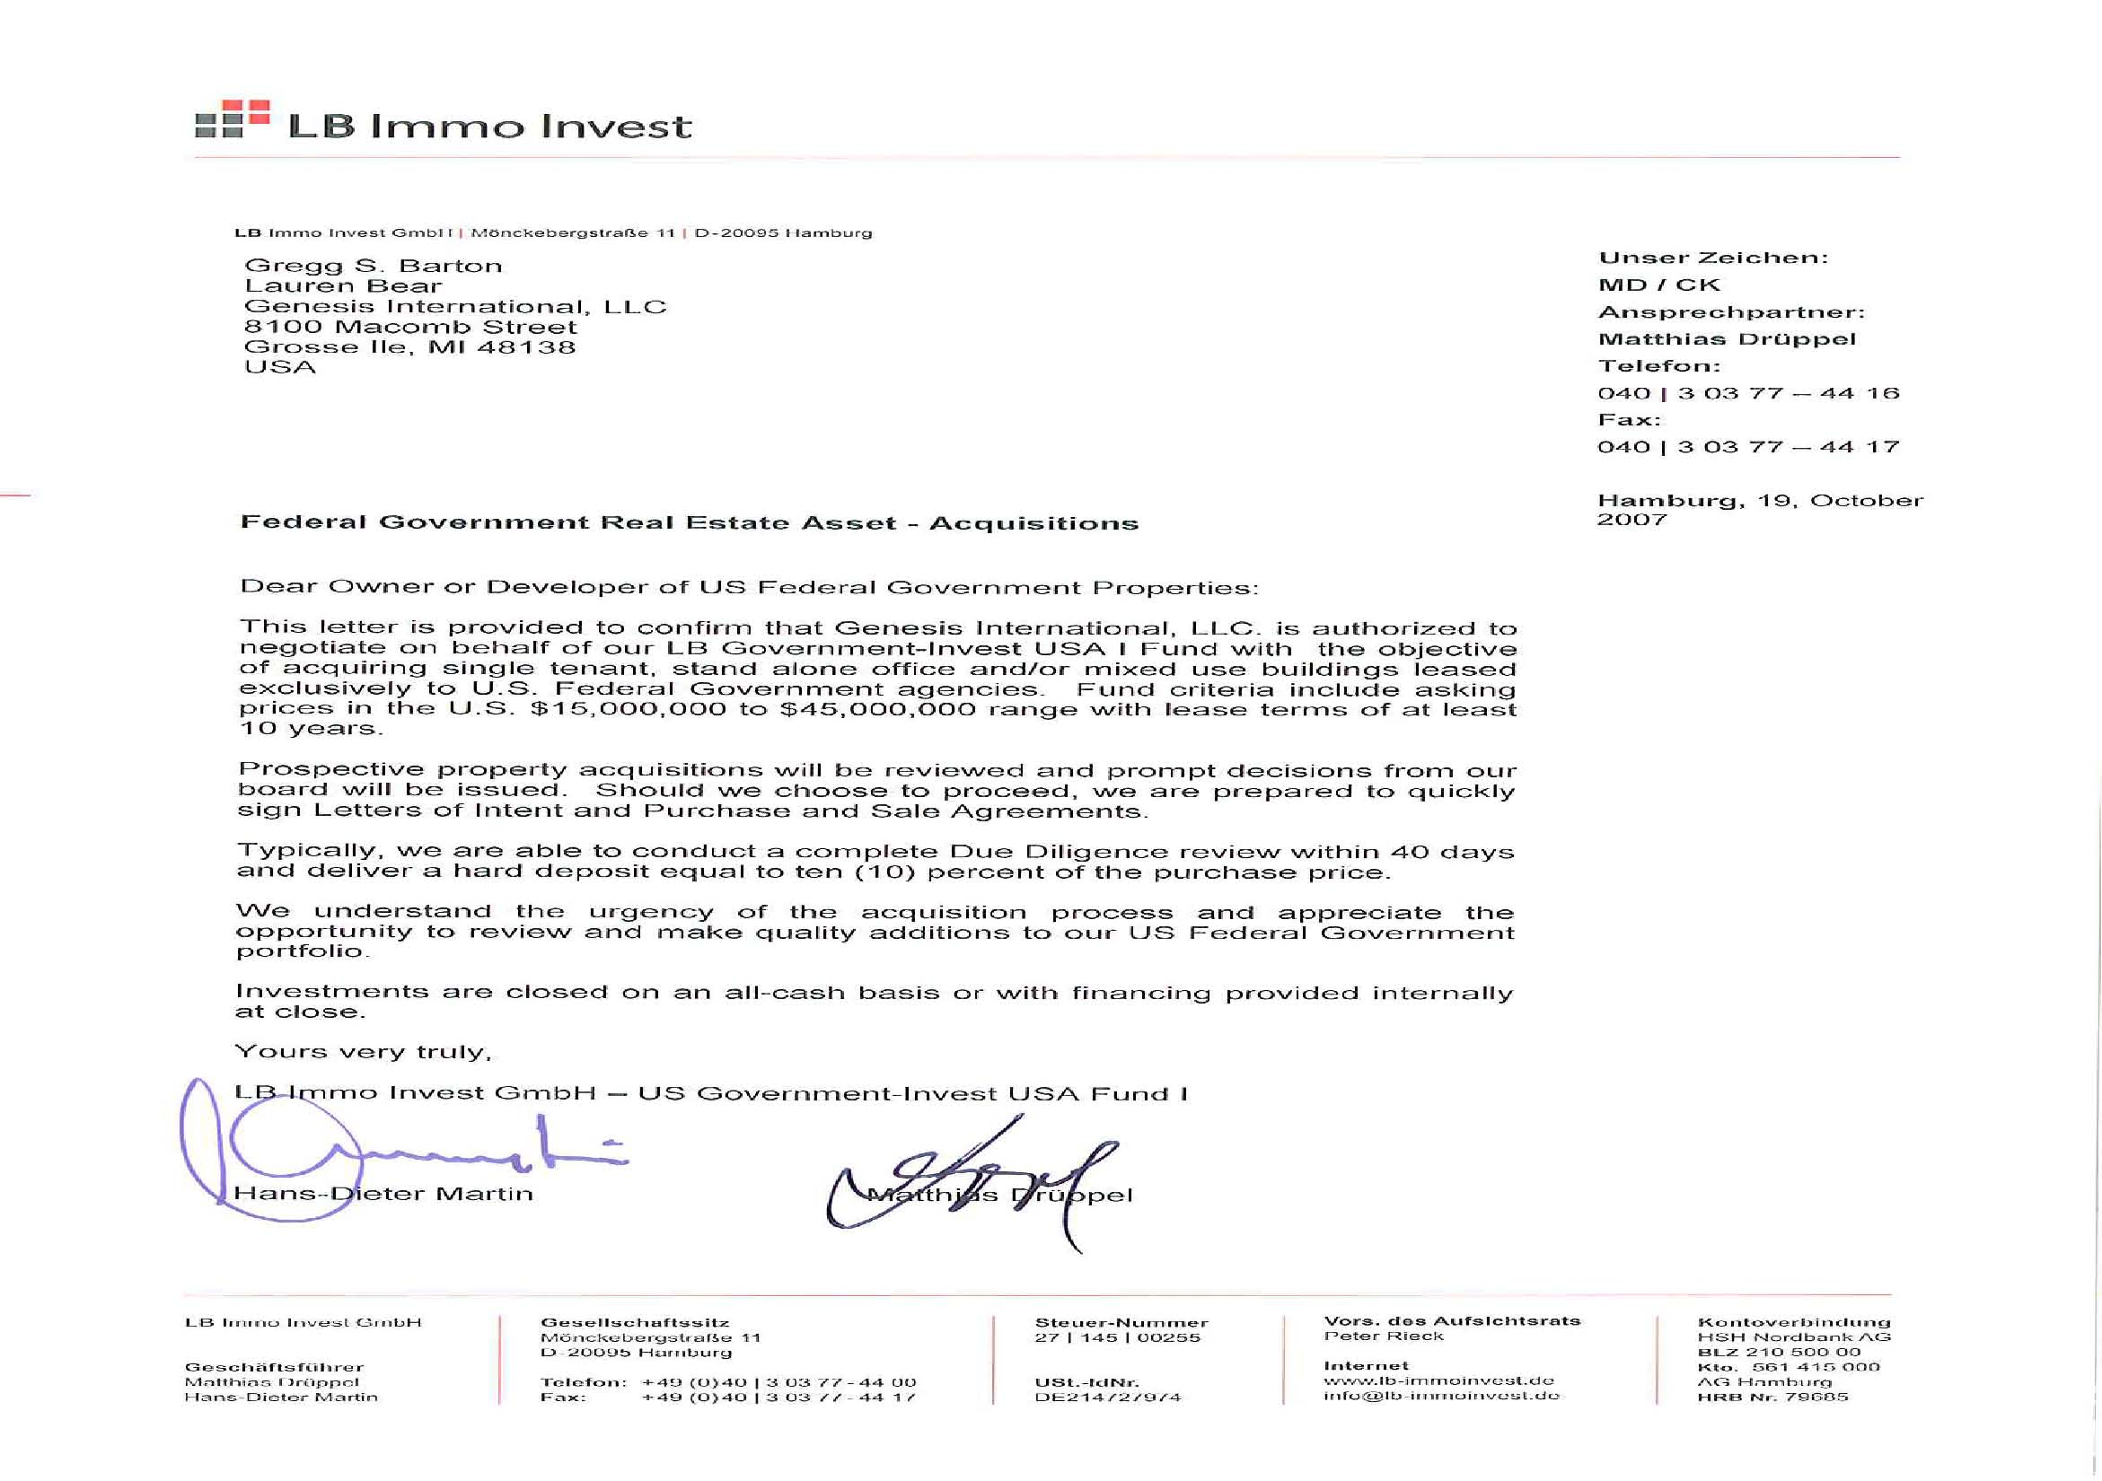
Engagement Letter – LB Immo Invest GmbH

Slide 25
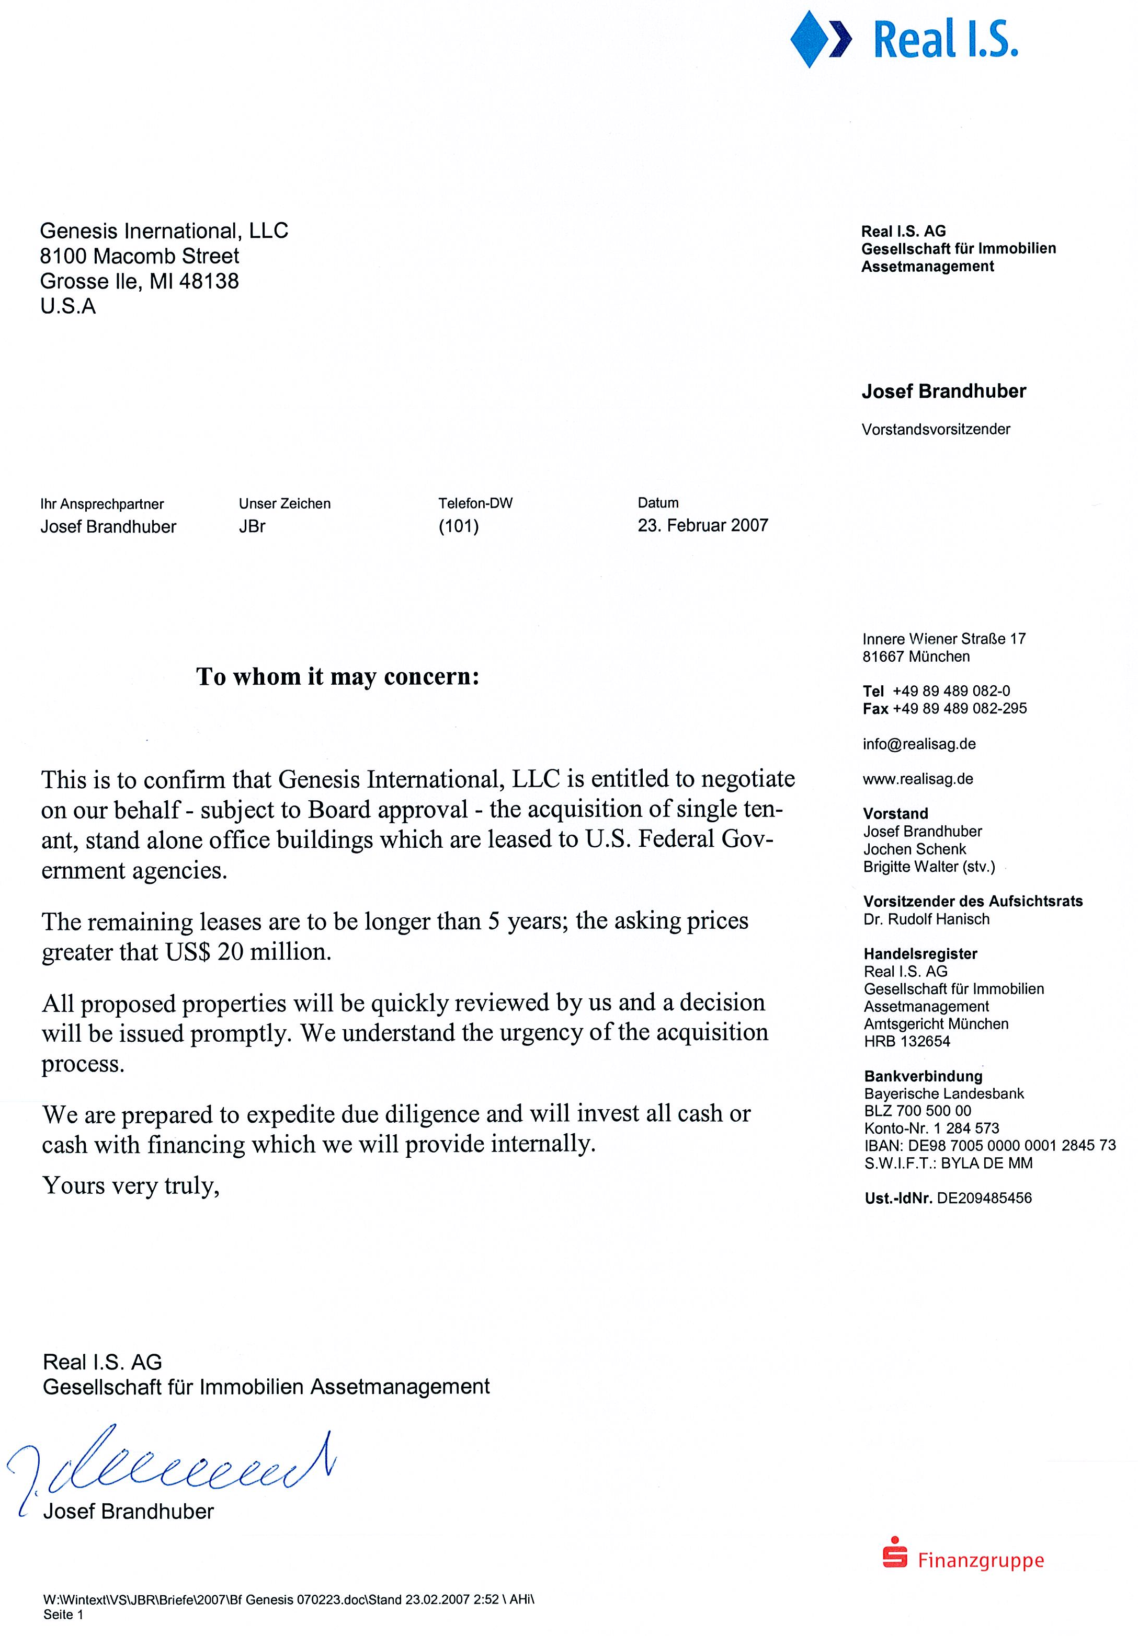
Engagement Letter – Real I.S.

